Slide 1
Marker in NER & RE
Packed Levitated Marker for Entity and Relation Extraction
A Frustratingly Easy Approach for Entity and Relation Extraction
武乐飞
2022.04.08

Slide 2
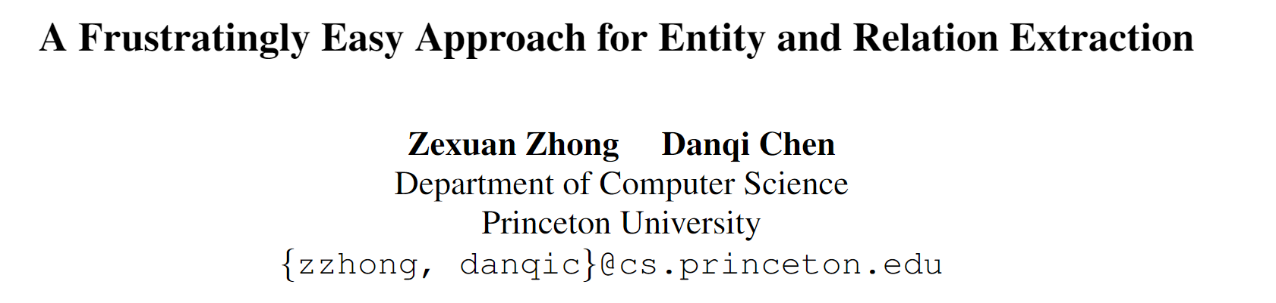
A Frustratingly Easy Approach for Entity and Relation Extraction 回顾
发表：NAACL 2021
作者&单位：陈丹琦，普林斯顿大学
开源代码：https://github.com/princeton-nlp/PURE
一般认为joint好于pipeline模型，但本文重新考虑了Entity and Relation Extraction下的pipeline模型，分别建立entity model and relation model独立训练，引入了Entity marker，通过Entity pairs遍历识别关系，取得了优于joint模型的性能，并认真分析了其原因。

Slide 3
A Frustratingly Easy Approach for Entity and Relation Extraction 回顾
研究动机
长期以来，普遍认为，由于pipeline模型存在的缺点，比如：误差积累、实体对冗余、交互缺失等，joint通过任务联合训练可以取得更好效果。
但Joint model真的优于Pipeline model吗？

Slide 4
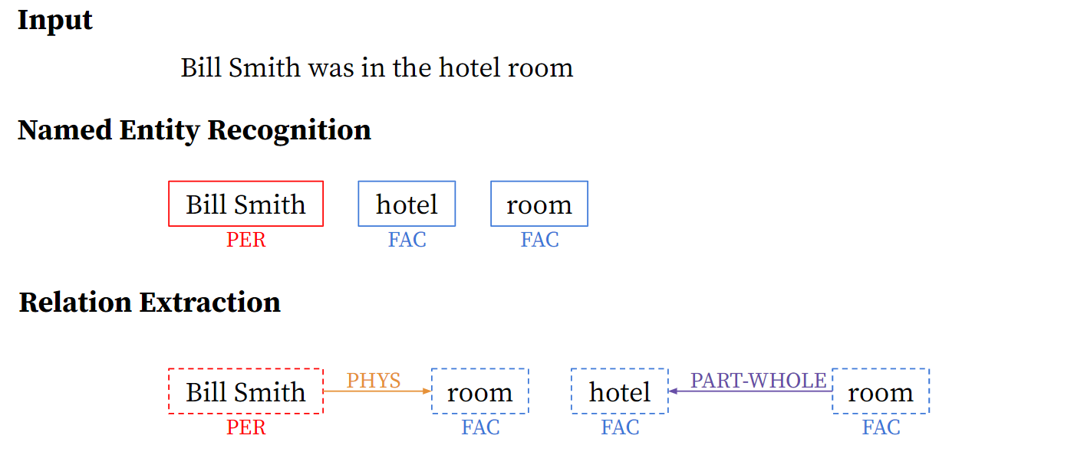
A Frustratingly Easy Approach for Entity and Relation Extraction 回顾
问题定义

Slide 5
A Frustratingly Easy Approach for Entity and Relation Extraction 回顾
主要工作
Pipline方法，NER 和 RE独立训练，并Sota；
RE的输入层融合Entity Type信息十分重要；
提出了一种batch近似方法，就实现8-16倍的推断提速。(Levitated Marker )

Slide 6
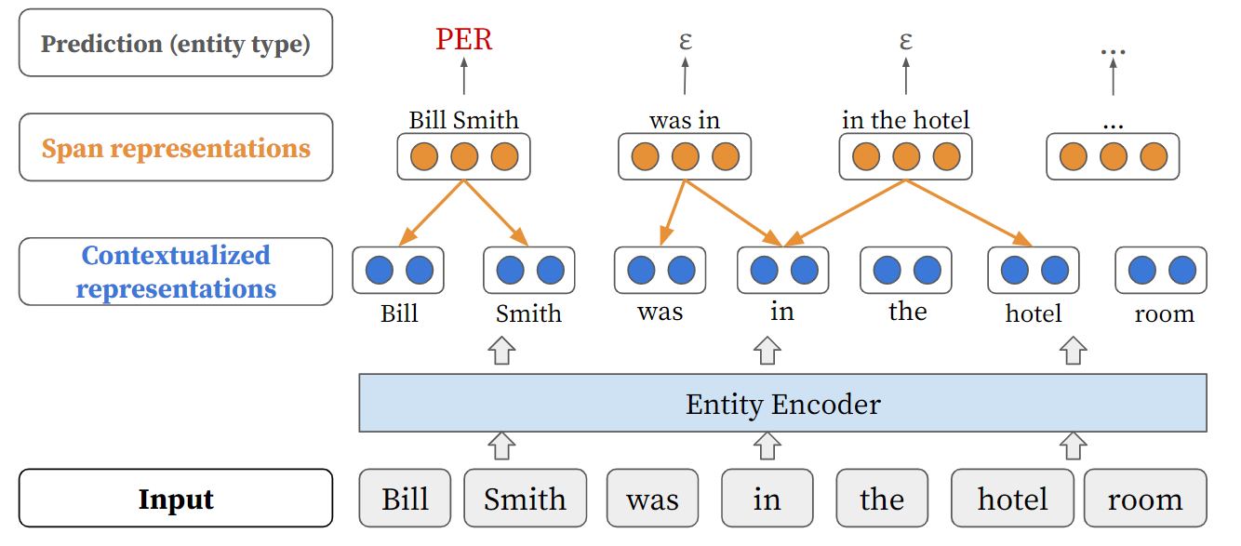
A Frustratingly Easy Approach for Entity and Relation Extraction 回顾
模型：NER
Span based NER, max_entity_L=8

Slide 7
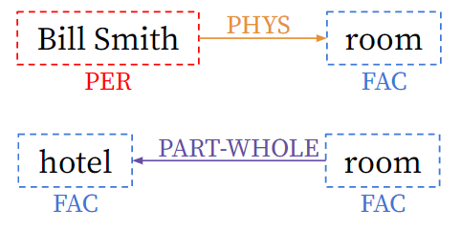
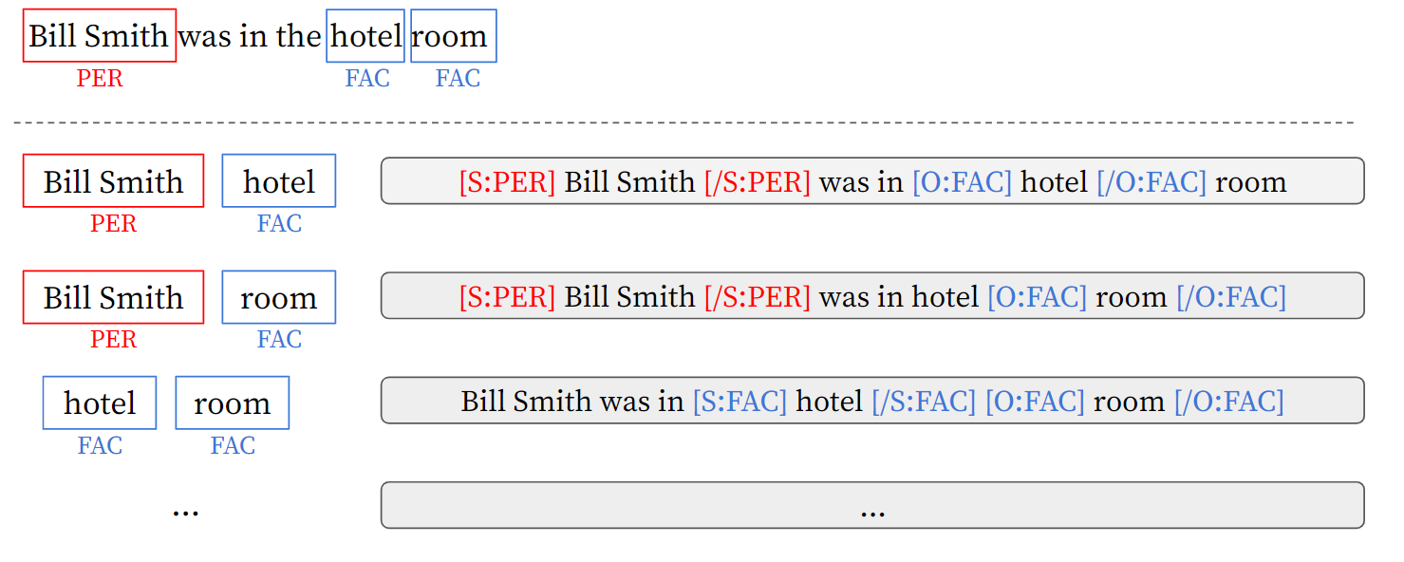
A Frustratingly Easy Approach for Entity and Relation Extraction 回顾
模型：RE
Gold RE
Entity type mark; 一个样本识别一种关系

Slide 8
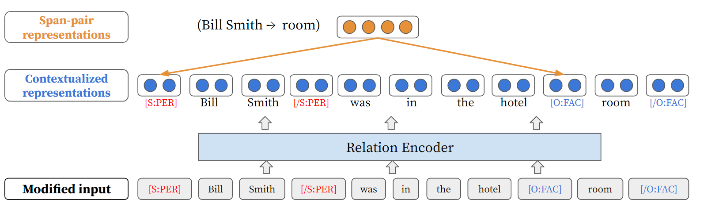
A Frustratingly Easy Approach for Entity and Relation Extraction 回顾
模型：RE
Gold RE
拼接subject_start和object_end

Slide 9
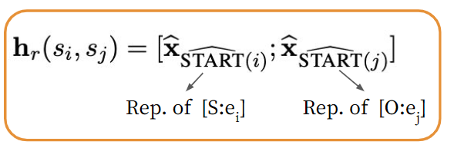
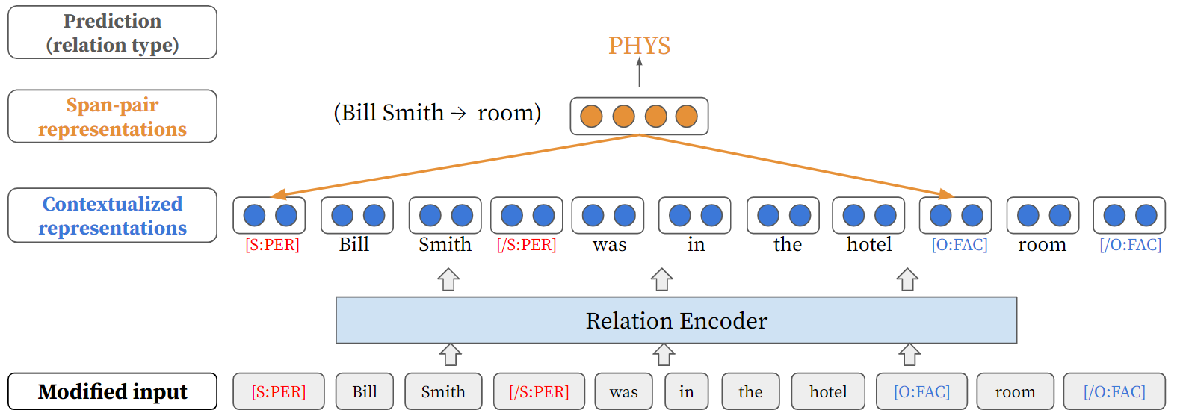
A Frustratingly Easy Approach for Entity and Relation Extraction 回顾
模型：RE
拼接subject_start和object_end

Slide 10
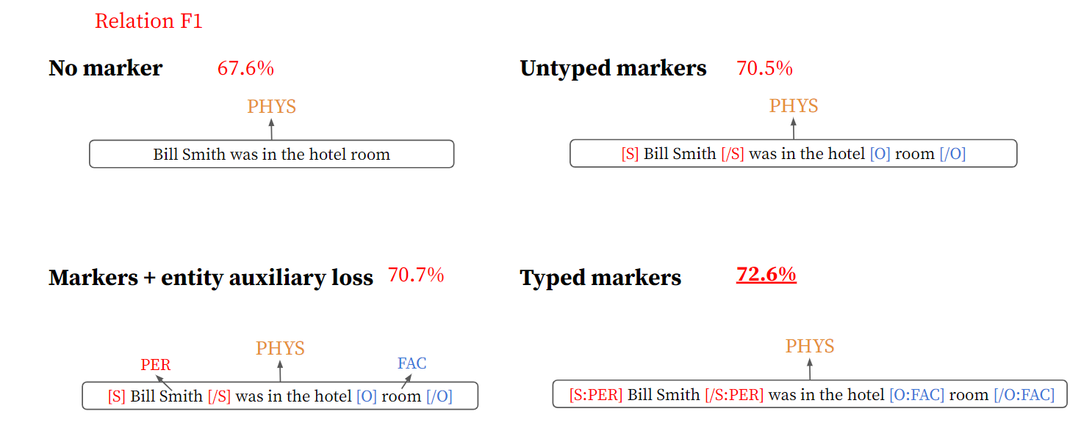
A Frustratingly Easy Approach for Entity and Relation Extraction 回顾
Typed Markers的影响

Slide 11
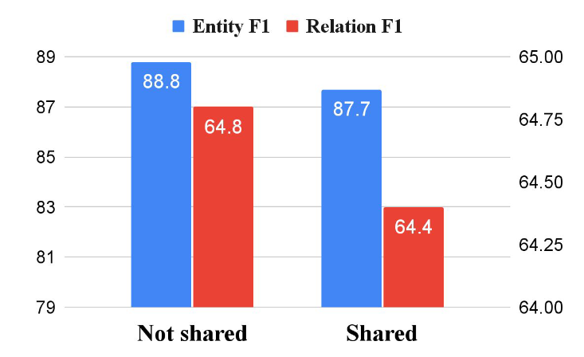
A Frustratingly Easy Approach for Entity and Relation Extraction 回顾
Pipline可以优于Joint
Pipline
Joint

Slide 12
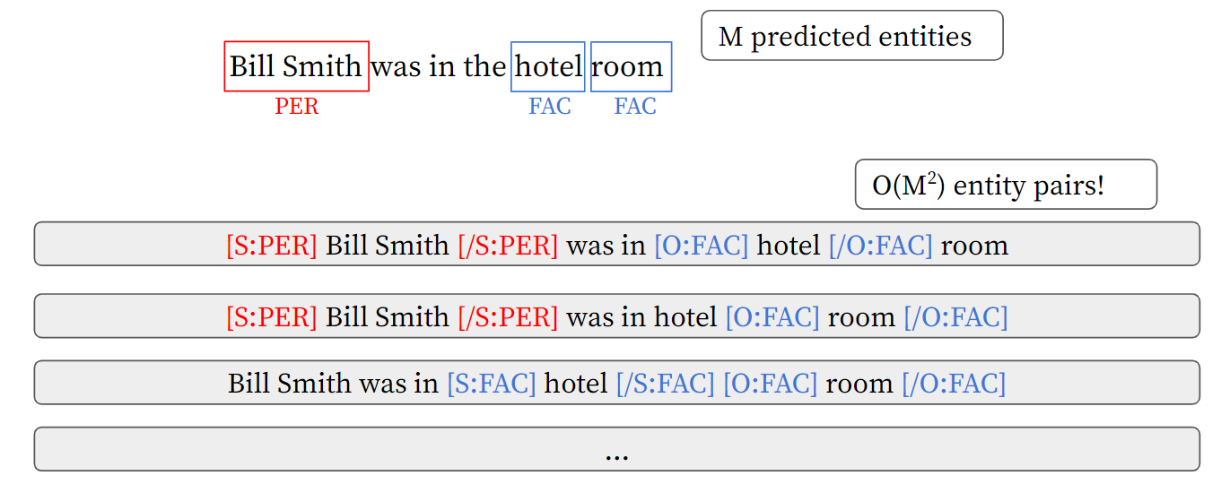
A Frustratingly Easy Approach for Entity and Relation Extraction 回顾
RE识别速度慢

Slide 13
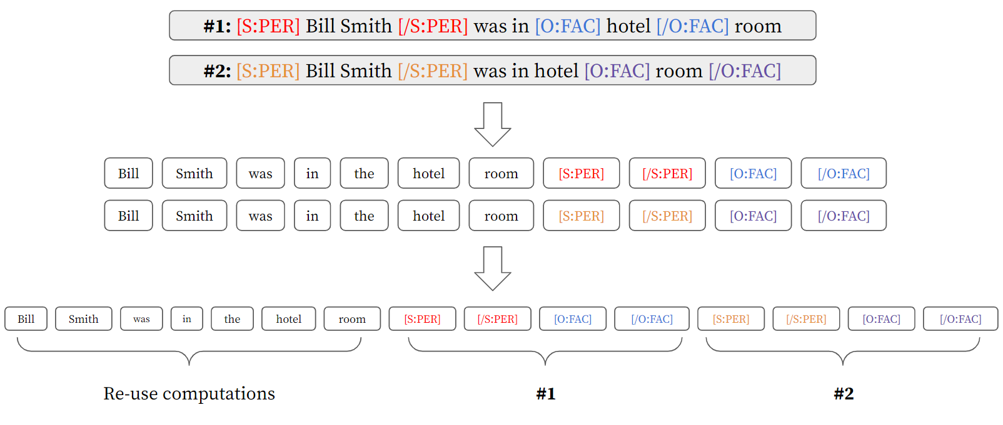
A Frustratingly Easy Approach for Entity and Relation Extraction 回顾
Approximation Model

Slide 14
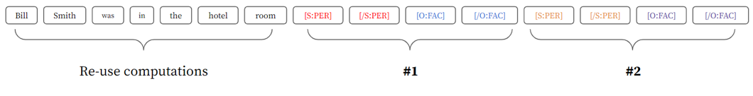
A Frustratingly Easy Approach for Entity and Relation Extraction 回顾
Position sharing
Position

Slide 15
A Frustratingly Easy Approach for Entity and Relation Extraction 回顾
Position sharing
Position_id

Slide 16


A Frustratingly Easy Approach for Entity and Relation Extraction 回顾
Levitated Marker：悬浮标记
S:PER - > unused1
/S:PER - > unused2
…
PHYS
No-relation
Gold RE
BERT
Input_id
Position_id

Slide 17
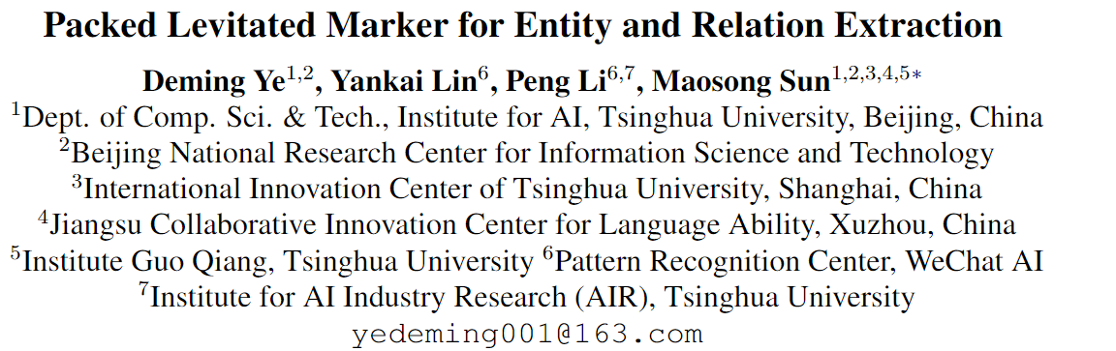
Packed Levitated Marker for Entity and Relation Extraction
发表：ACL 2022
作者&单位：孙茂松组，清华NLP
开源代码：https://github.com/thunlp/PL-Marker#Training-script
考虑span及span pairs之间的交互，采用Packed Levitated Marker策略。对于NER，打包相近邻span，对于RE，以subject为导向的打包，将每个subject及其所有object打包(排列组合)。

Slide 18
Packed Levitated Marker for Entity and Relation Extraction
研究动机
信息抽取工作侧重于研究如何从预训练的编码器中获得更好的span表示，但主要问题是忽略了span（pairs）之间的相互关系。通过Packed Levitated Marker ，实现这种交互，获取更高质量span表示。

Slide 19
Packed Levitated Marker for Entity and Relation Extraction
问题定义

Slide 20
Packed Levitated Marker for Entity and Relation Extraction
主要工作
Levitated Marker for NER\RE，部分Sota；
基于PURE，改进Levitated Marker；
两种打包策略：
Neighborhood-oriented Packing for Span：近邻打包
Subject-oriented Packing for Span Pair：subject based 打包

Slide 21
Packed Levitated Marker for Entity and Relation Extraction
Span representation 相关工作
1. T-Concat: span首尾token直接拼接；
2. Solid Marker: 原句中span首尾插入mark
3. Levitated Marker: 句子末尾插入mark，并共享position

Slide 22
Packed Levitated Marker for Entity and Relation Extraction
Enhance span representation 相关工作
1. Span Pre-training: 预训练阶段，就考虑span；
2. Knowledge Infusion: 外部知识增强span，如外部图谱、词汇等；
3. Structural Extension: 结构内增强span，仿射、图传播等.

Slide 23
Packed Levitated Marker for Entity and Relation Extraction
模型
结构简单：BERT+MLP, 重点在数据端

Slide 24
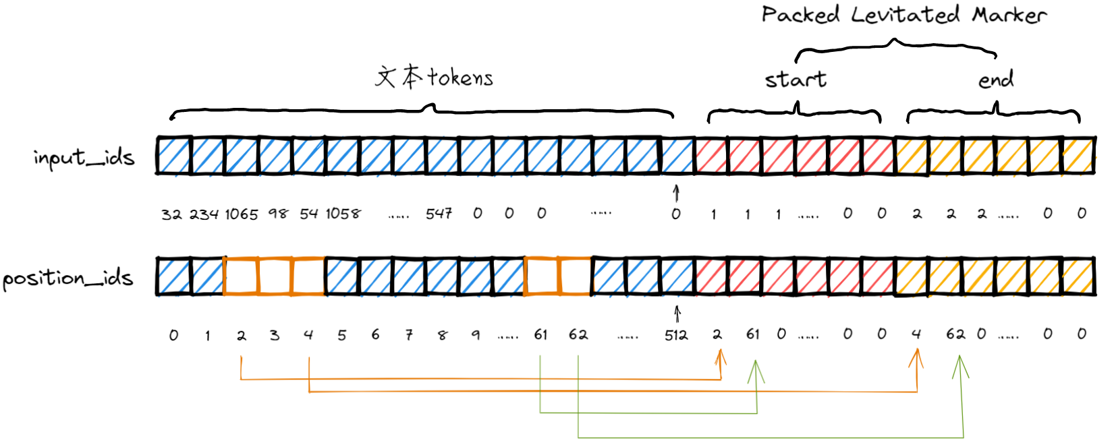
Packed Levitated Marker for Entity and Relation Extraction
模型:NER
1个Group，尺寸为256
每个句子枚举256个span

Slide 25
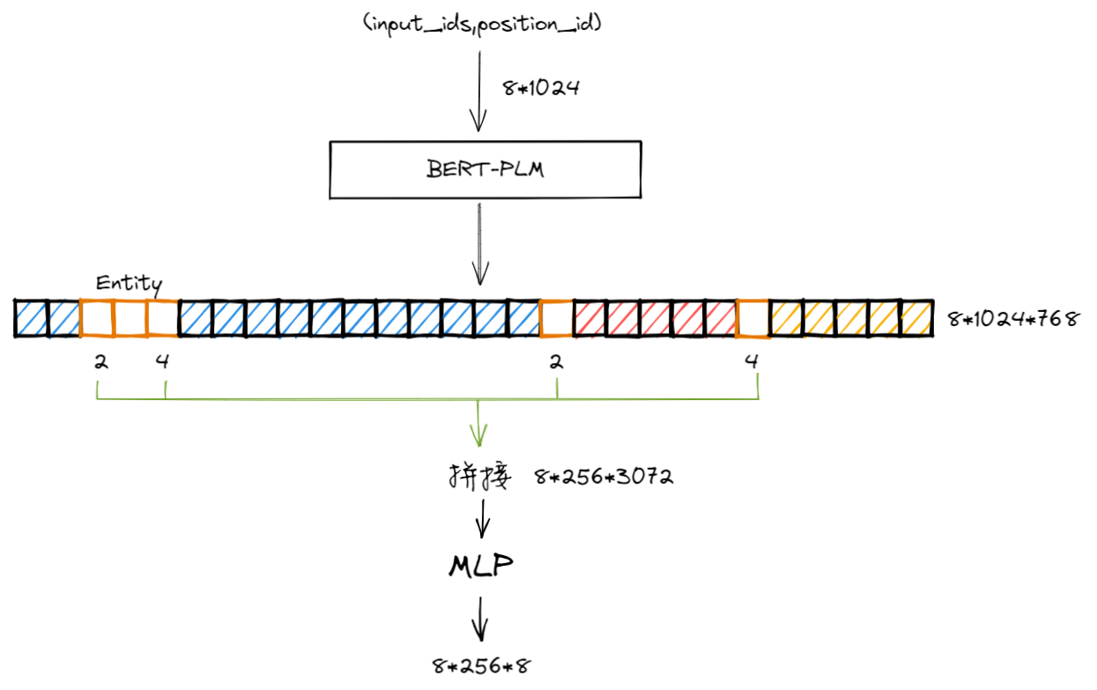
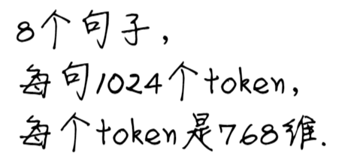
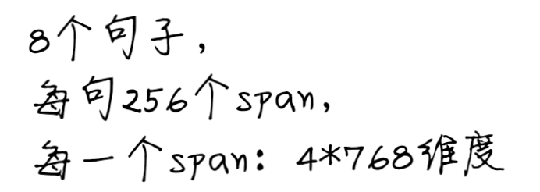
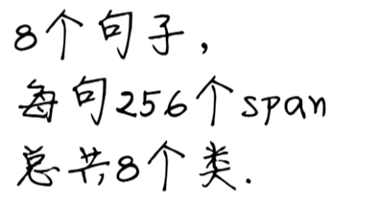
Packed Levitated Marker for Entity and Relation Extraction
模型:NER

Slide 26
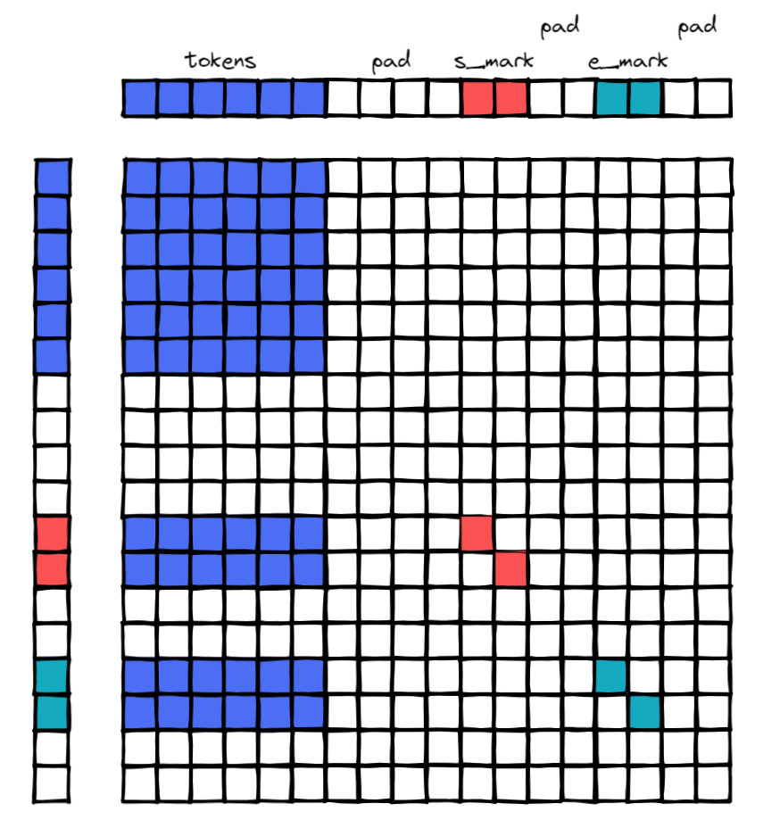
Packed Levitated Marker for Entity and Relation Extraction
Attention_mask
悬浮标记仅配对可见，其他悬浮标记不可见
关注文本标记以聚合信息
定向注意掩码矩阵

Slide 27
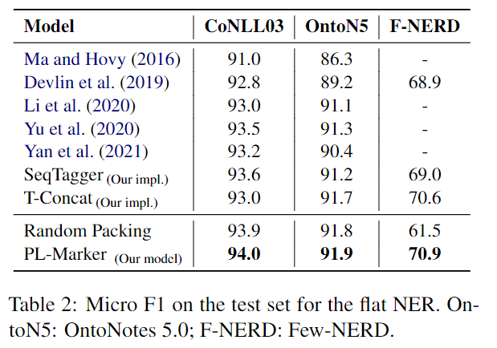

Packed Levitated Marker for Entity and Relation Extraction
NER：结果
关于打包：
每句话枚举256个span，按照start和end排，按近邻程度切分为多个group，1个Group最多为k.
打包策略在数据量大，类别多时效果显著。F-NERD细粒度实体，65类。

Slide 28
Packed Levitated Marker for Entity and Relation Extraction
模型:NER，打包
1个Group，尺寸为256
每个句子枚举256个span

Slide 29
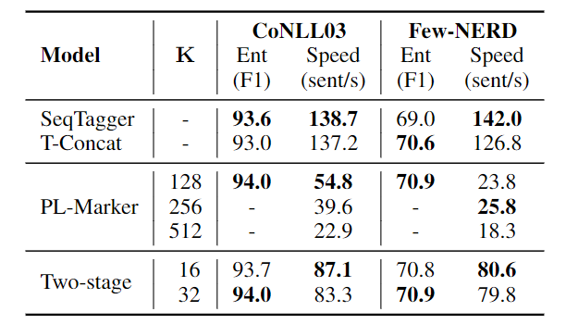
Packed Levitated Marker for Entity and Relation Extraction
模型:NER，打包
打包尺寸的设置
对NER效果不大
为了凑故事
打包的作用：为了利用负例？

Slide 30
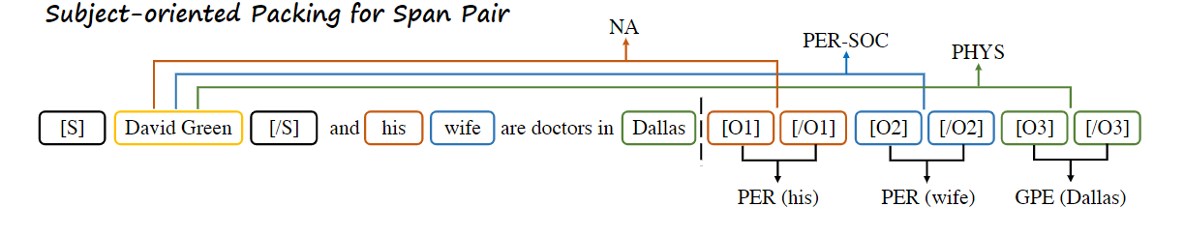
Packed Levitated Marker for Entity and Relation Extraction
模型:RE
一个实体为Subject，其余为object，匹配。三个实体，生成三个样本
Subject两边加solid mark
Object: Levitated Marker

Slide 31
Packed Levitated Marker for Entity and Relation Extraction
模型:RE
一个样本中包含全部关系

Slide 32
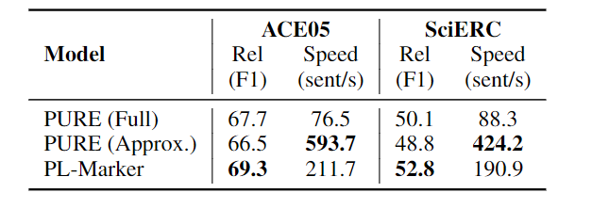
Packed Levitated Marker for Entity and Relation Extraction
模型:RE，关于速度
一条样本预测一个关系，solid mark
一条样本预测多个关系，levitated mark
一条样本预测一个关系，s+l mark

Slide 33
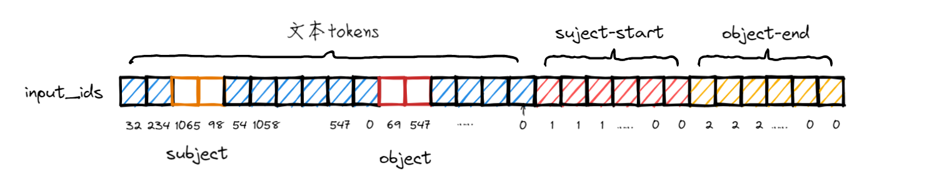
Packed Levitated Marker for Entity and Relation Extraction
模型:RE

Slide 34
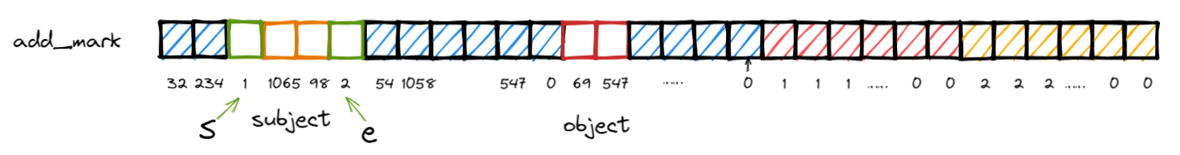
Packed Levitated Marker for Entity and Relation Extraction
模型:RE

Slide 35
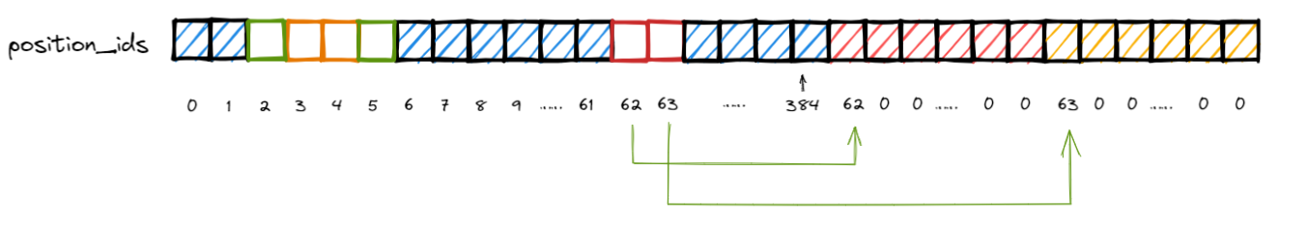

Packed Levitated Marker for Entity and Relation Extraction
模型:RE
用solid修饰subject，用levitated 修饰object

Slide 36
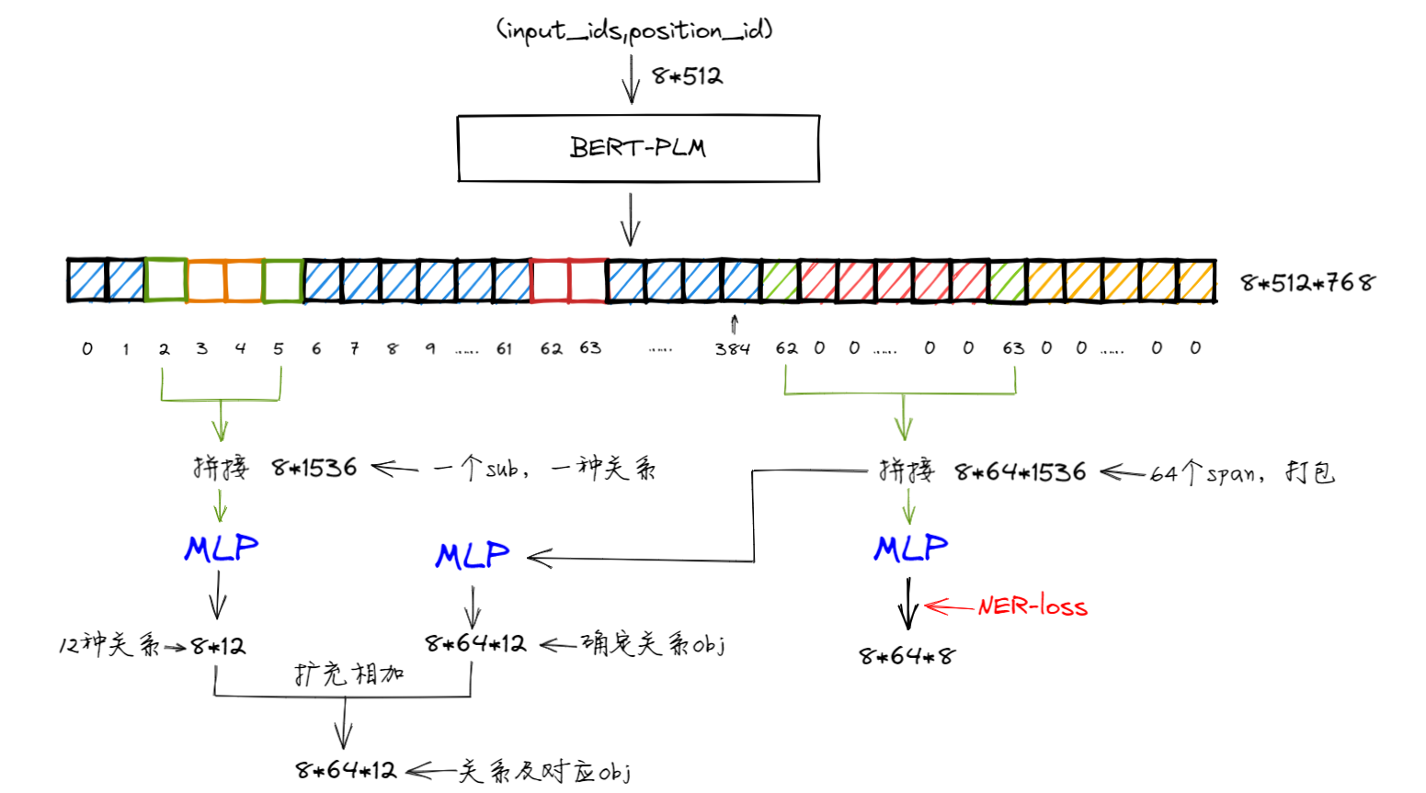
Packed Levitated Marker for Entity and Relation Extraction

Slide 37
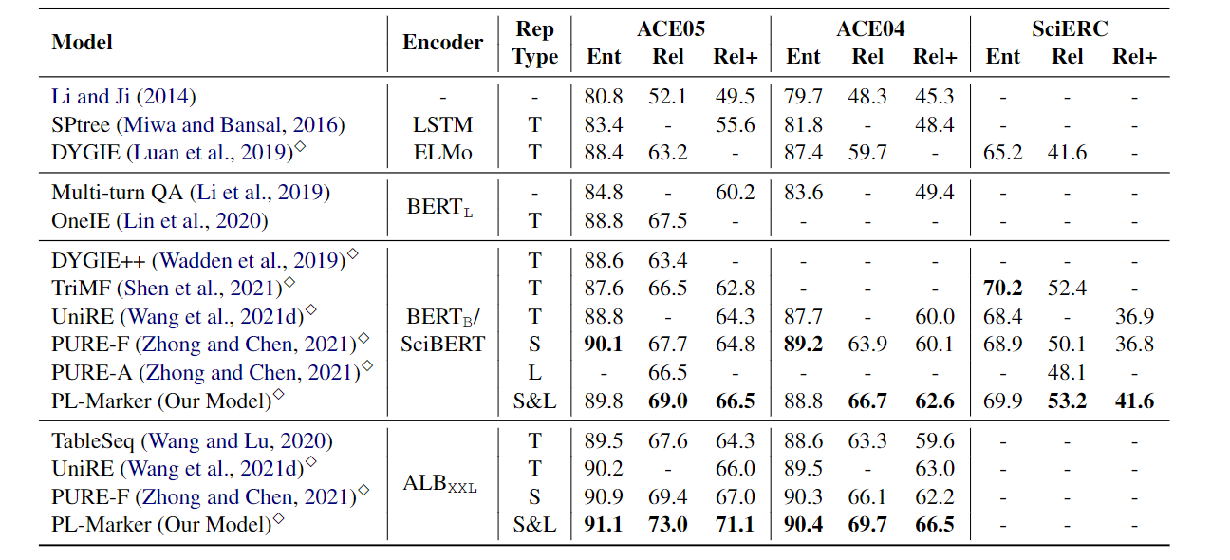
Packed Levitated Marker for Entity and Relation Extraction
RE性能

Slide 38
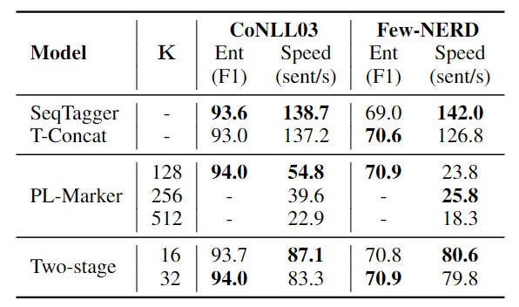
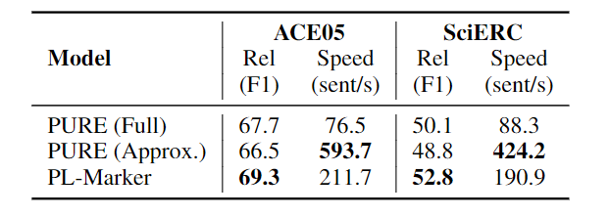
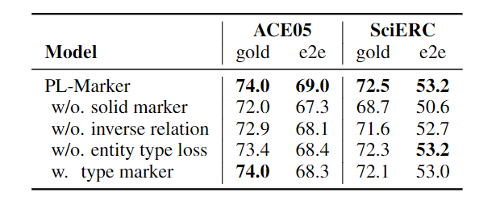
Packed Levitated Marker for Entity and Relation Extraction
消融实验
Span model(NER) 速度
Span pairs(RE) 速度
逆关系有用
Solid和Levitated配合更佳
实体损失比实体类型减少级联错误
实体损失为了二次矫正
消融实验

Slide 39
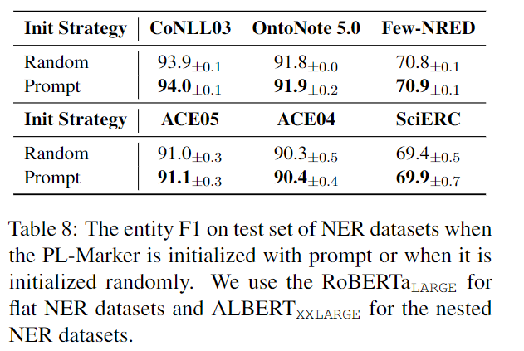
Packed Levitated Marker for Entity and Relation Extraction
附录：Prompt Initialization for NER
原来的Mark标记的嵌入式随机初始化的
现在使用[Mark]和entity作为span标记
没讲清楚，可能下一篇？

Slide 40
Packed Levitated Marker for Entity and Relation Extraction
总结
声称是end-2-end，又说是pipline，需要先识别实体；但代码中又同时识别了实体，代码与论文不符；
确实不是end-2-end
标题中的packed，论文中没有深入分析背后原因，即position sharing为什么有用？
RE中增加了entity type loss，不是已经知道pre entity type了吗？为了二次矫正！
带有entity type的 RE 模型在端到端设置中的性能略低于带有entity loss的模型，它表明，如果我们采用类型标记作为输入特征，来自 NER 模型的实体类型预测误差可能会传播到 RE 模型。

